Slide 1
Chemical Equilibrium

Slide 2


Fast Initial Step
Because Rate_{f} = Rate_{r} ,
Solving for [NOBr₂] gives us
Can also write as:

Slide 3
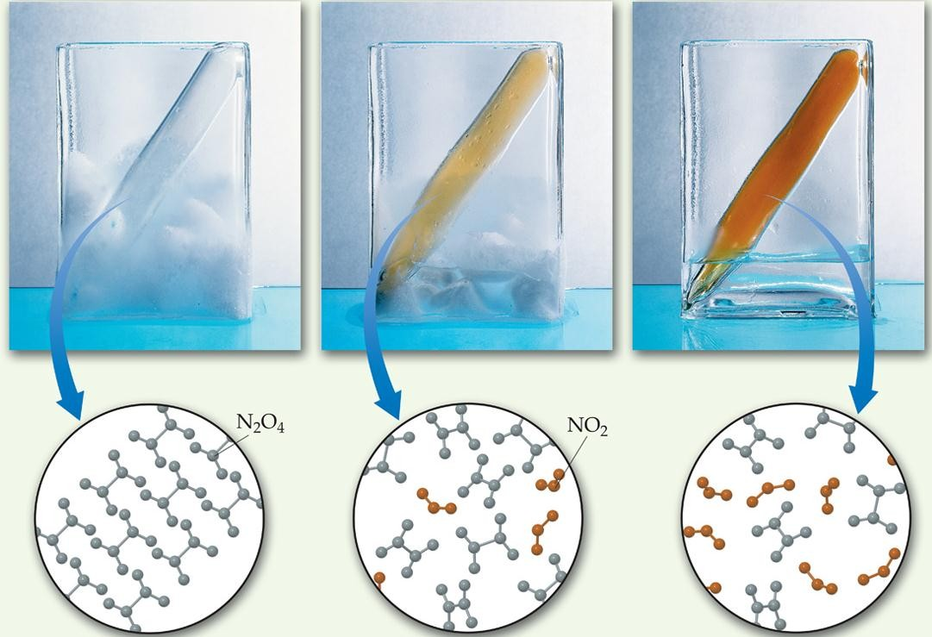
The Concept of Equilibrium
Chemical equilibrium occurs when a reaction and its reverse reaction proceed at
the same rate.
Equilibrium

Slide 4
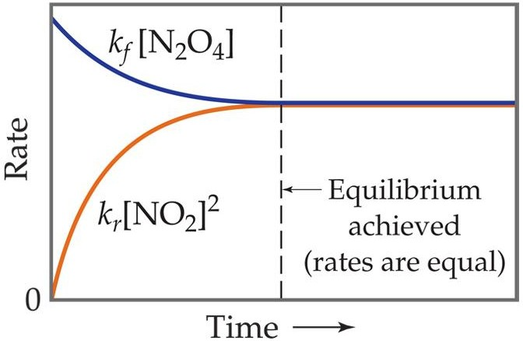

The Concept of Equilibrium
As a system approaches equilibrium, both the forward and reverse reactions are occurring.
At equilibrium, the forward and reverse reactions are proceeding at the same rate.

Slide 5
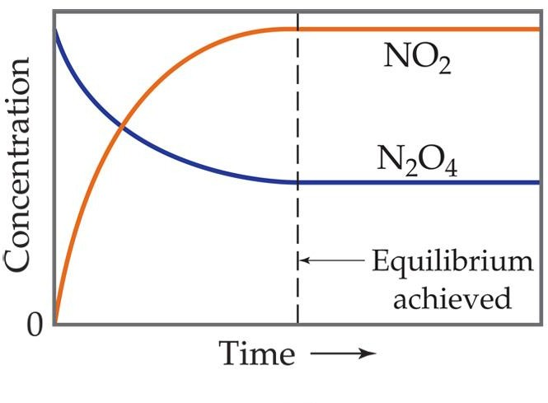
A System at Equilibrium
Once equilibrium is achieved, the amount of each reactant and product remains constant.

Slide 6
A System at Equilibrium
Rates become equal Concentrations become constant

Slide 7

Depicting Equilibrium
In a system at equilibrium, both the forward and reverse reactions are running simultaneously. We write the chemical equation with a double arrow:

Slide 8
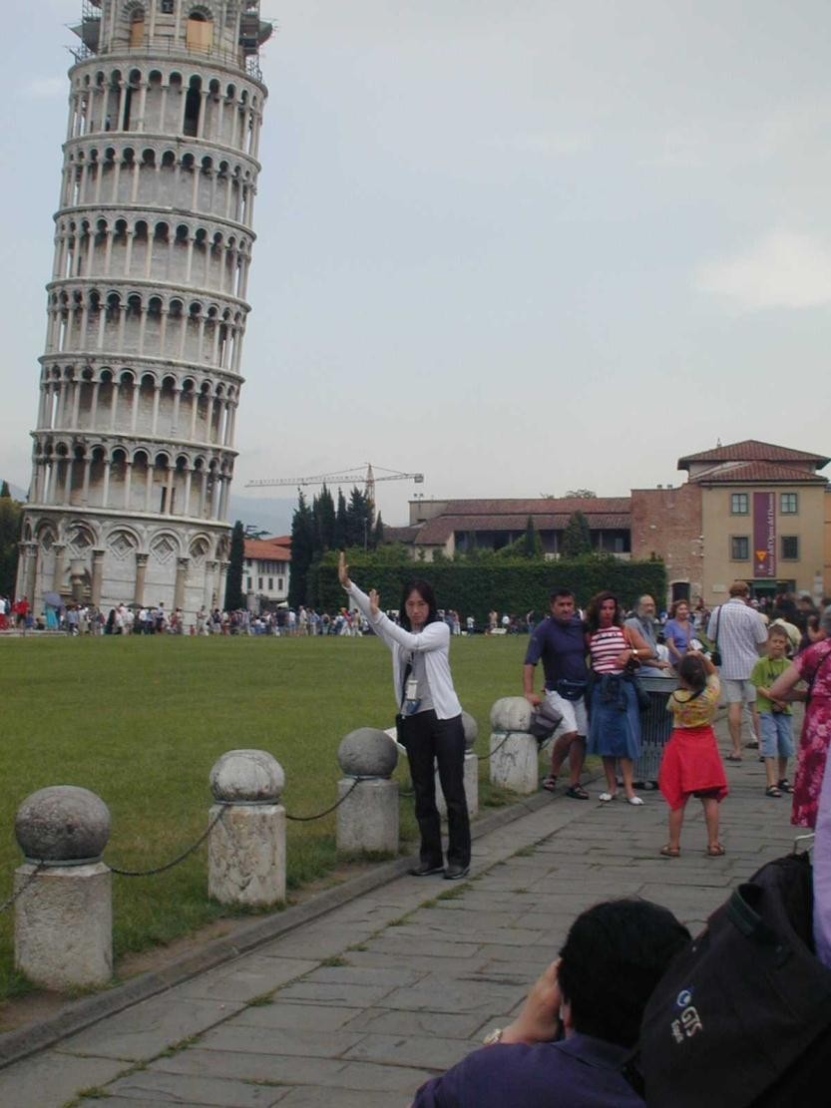
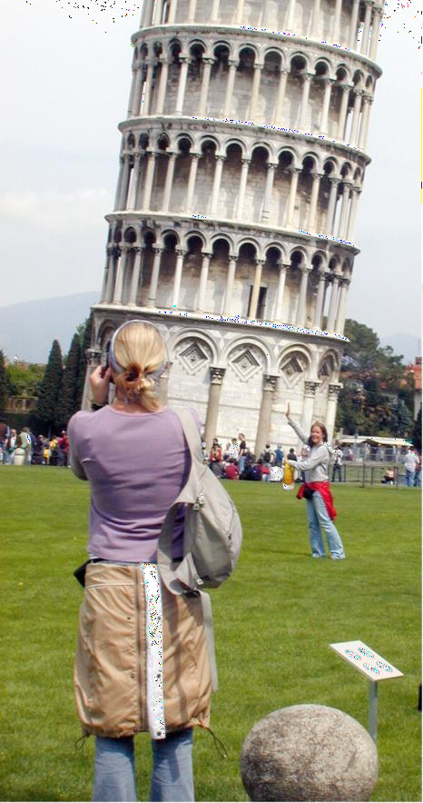
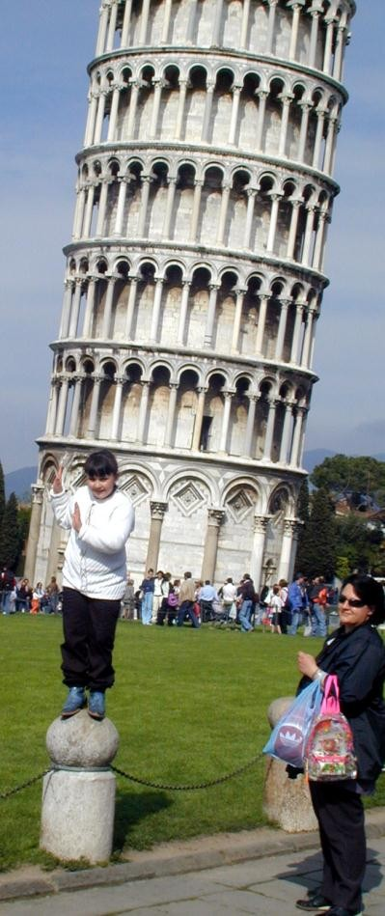
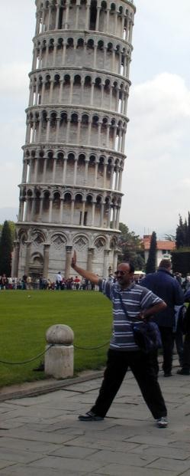
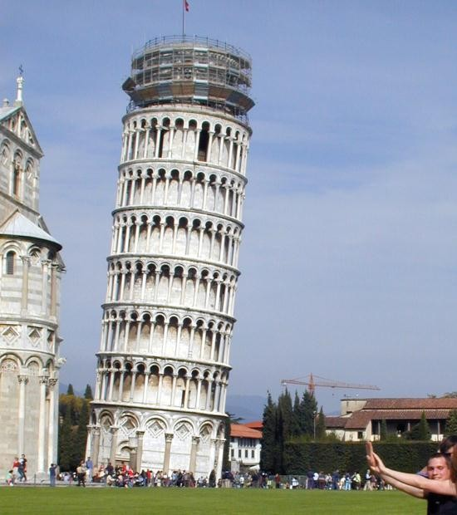





Slide 9
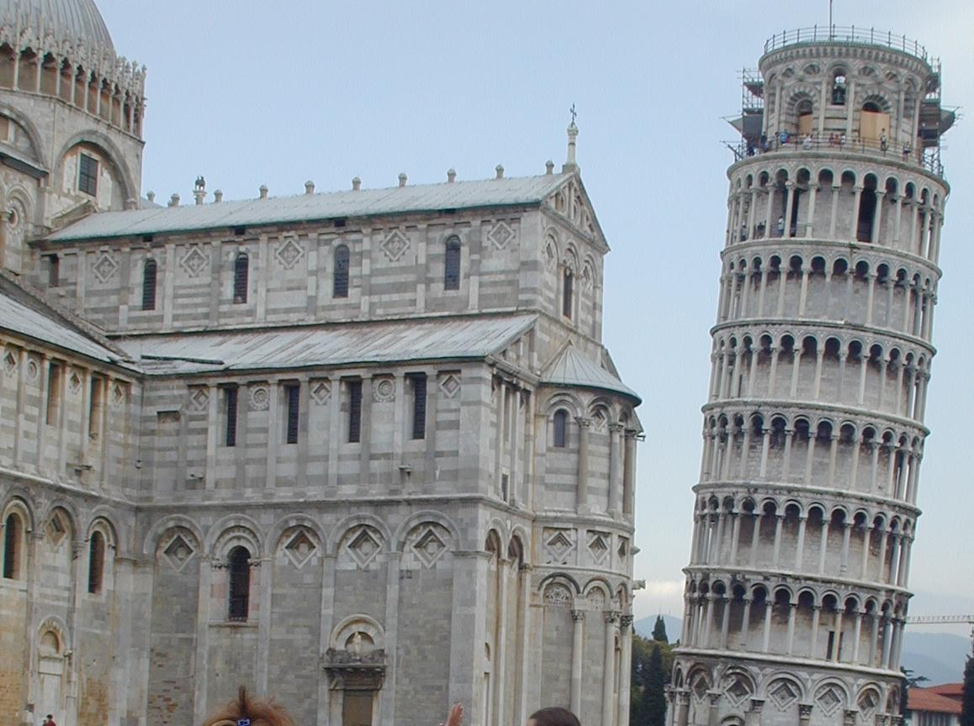

Slide 10
The Equilibrium Constant

Slide 11




The Equilibrium Constant
Forward reaction:
Reverse reaction:
Rate law
Rate Law

Slide 12


The Equilibrium Constant
At equilibrium
Rearranging gives:

Slide 13

The Equilibrium Constant
The ratio of the rate constants is a constant (as long as T is constant).
The expression becomes

Slide 14

The Equilibrium Constant
To generalize, the reaction:
Has the equilibrium expression:
This expression is true even if you don’t know the elementary reaction mechanism.

Slide 15
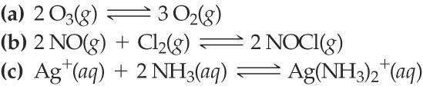

SAMPLE EXERCISE 15.1 Writing Equilibrium-Constant Expressions
Write the equilibrium expression for K_{c} for the following reactions:

Slide 16

PRS here…

Slide 17


SAMPLE EXERCISE 15.1 Writing Equilibrium-Constant Expressions
Write the equilibrium expression for K_{c} for the following reactions:
Solution
Analyze: We are given three equations and are asked to write an equilibrium-constant expression for each. Plan: Using the law of mass action, we write each expression as a quotient having the product concentration terms in the numerator and the reactant concentration terms in the denominator. Each term is raised to the power of its coefficient in the balanced chemical equation.
Solve:
PRACTICE EXERCISE
Write the equilibrium-constant expression, K_{c} for

Slide 18
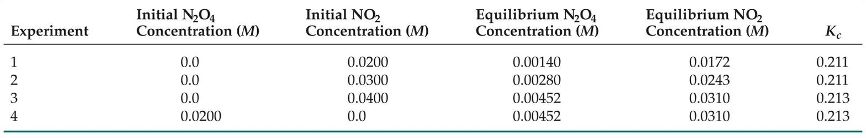

Equilibrium Can Be Reached from Either Direction
K_{c}, the final ratio of [NO₂]² to [N₂O₄], reaches a constant no matter what the initial concentrations of NO₂ and N₂O₄ are (with const T).

Slide 19
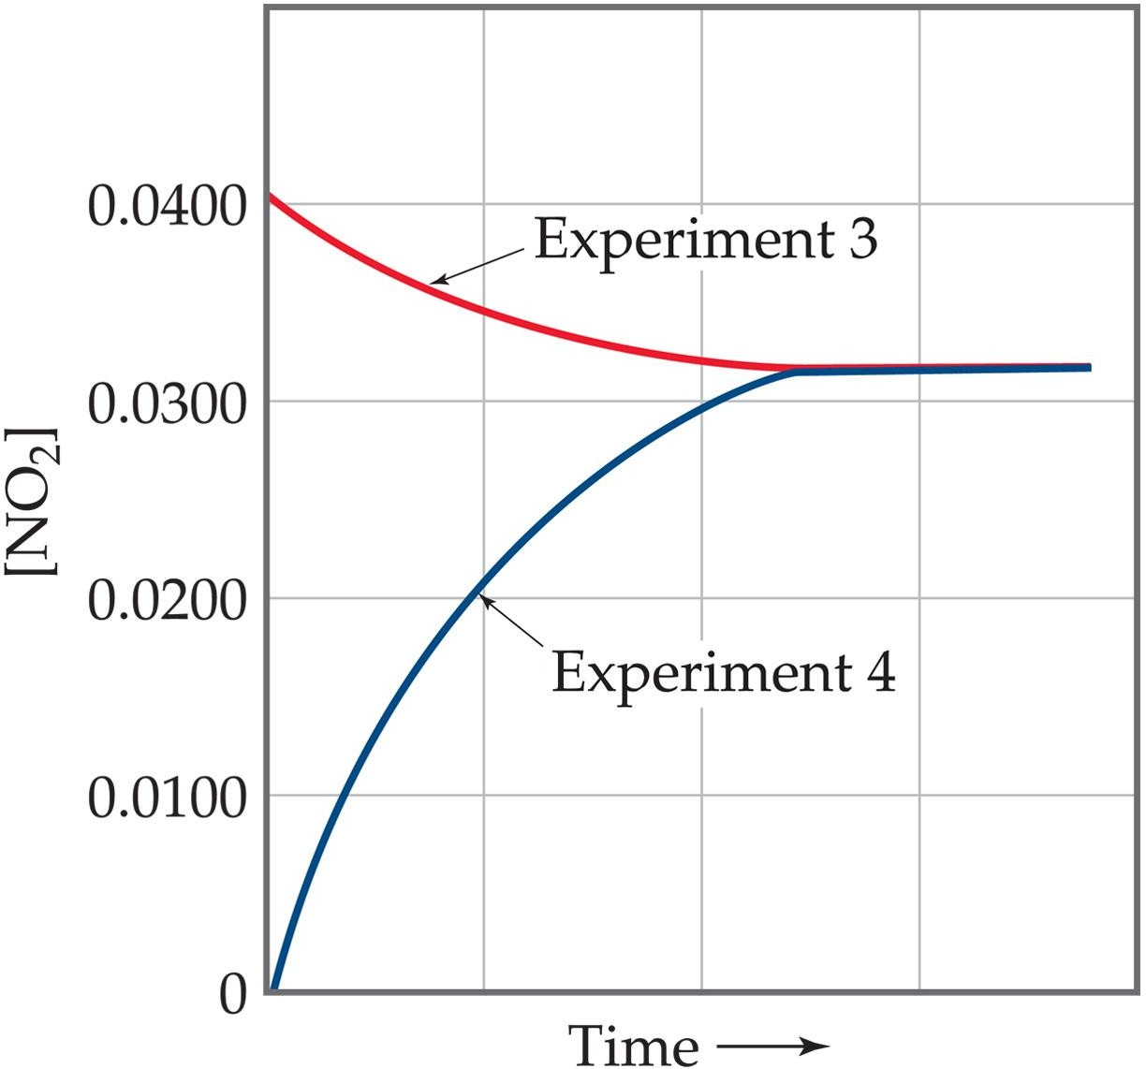

Equilibrium Can Be Reached from Either Direction
This graph shows data from the last two trials from the table.
QuickTime™ and TIFF (LZW) decompre e needed to see this pi

Slide 20

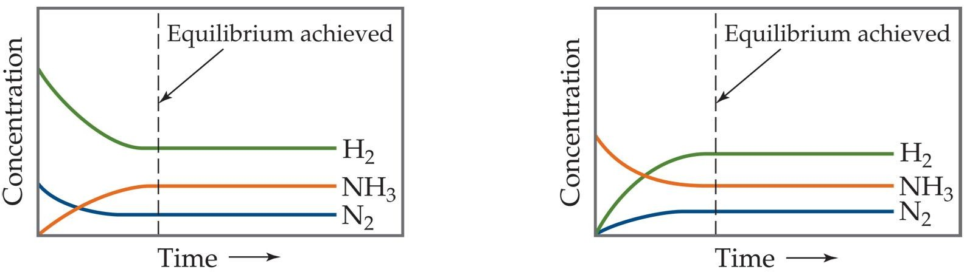
Equilibrium Can Be Reached from Either Direction
It does not matter whether we start with N₂ and H₂ or whether we start with NH₃. We will have the same proportions of all three substances at equilibrium.
What is the equilibrium expression?
Equilibrium

Slide 21
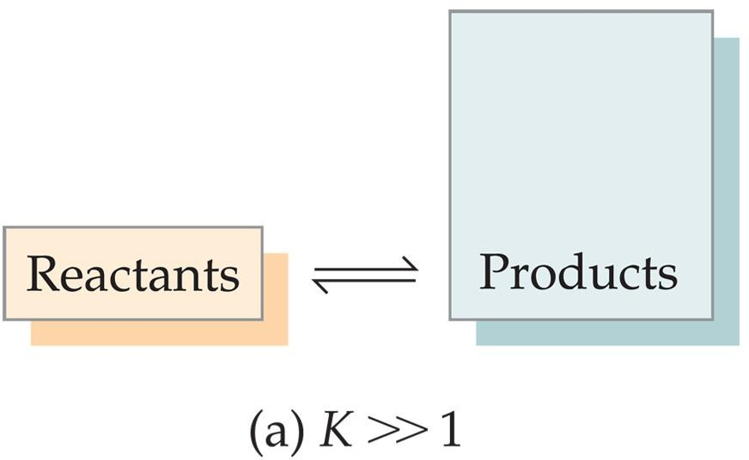
What Does the Value of K Mean?
If K >> 1, the reaction is product-favored; product predominates at equilibrium.

Slide 22
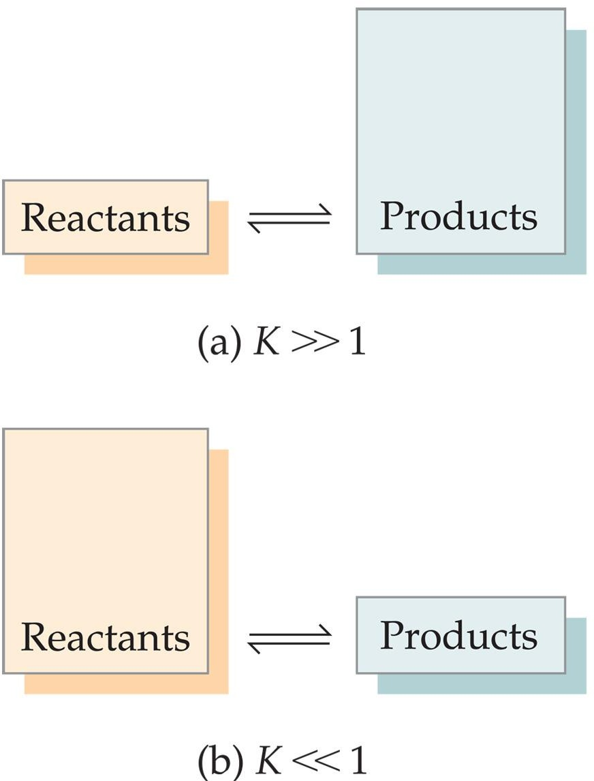
What Does the Value of K Mean?
If K >> 1, the reaction is product-favored; product predominates at equilibrium.
If K << 1, the reaction is reactant-favored; reactant predominates at equilibrium.

Slide 23




Manipulating Equilibrium Constants
The equilibrium constant of a reaction in the reverse reaction is the reciprocal of the equilibrium constant of the forward reaction.

Slide 24


Manipulating Equilibrium Constants
The equilibrium constant of a reaction that has been multiplied by a number is the equilibrium constant raised to a power that is equal to that number.

Slide 25
Manipulating Equilibrium Constants
The equilibrium constant for a net reaction made up of two or more steps can be found from the equilibrium constants for the individual steps.`
At 1565 K we have these equilibrium constants:
ans=2.9

Slide 26


The Equilibrium Constant
Because pressure is proportional to concentration for gases, the equilibrium expression can also be written in terms of partial pressures (instead of concentration):
Mixed versions are also used sometimes:

Slide 27


Relationship between K_{c} and K_{p}
From the ideal gas law we know that
= Pressure in terms of concentration

Slide 28
Relationship between K_{c} and K_{p}
Substituting P=[A]RT into the expression for K_{p} for each substance, the relationship between K_{c} and K_{p} becomes
K_{p} = K_{c} (RT)^{Δn}
Where:
Δn = (moles of gaseous product) – (moles of gaseous reactant)
Hint: ‗products–reactants‘ and ‗products over reactants‘ is a common theme in chemistry.

Slide 29
Heterogeneous Equilibrium

Slide 30

The Concentrations of Solids and Liquids Are Essentially Constant
Concentrations of liquids and solids can be obtained by dividing the density of the substance by its molar mass—and both of these are constants at constant temperature.

Slide 31
The Concentrations of Solids and Liquids Are Essentially Constant
Therefore, the concentrations of solids and liquids do not appear in the equilibrium expression
PbCl_{2 (s)}
^{Pb2+} (aq) ^{+ 2 Cl−}(aq)
K_{c} = [Pb²⁺] [Cl⁻]²

Slide 32
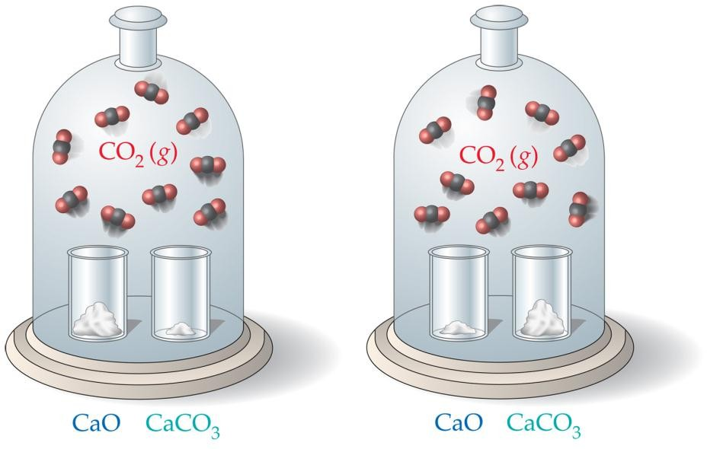
CaCO_{3 (s)}
^{CO}2 (g) ^{+ CaO}(s)
As long as some CaCO₃ or CaO remain in the system, the amount of CO₂ above the solid will remain the same.

Slide 33
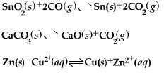
What Are the Equilibrium Expressions for These Equilibria?

Slide 34

The real scoop: units of equilibrium constants
Equilibrium constants are really defined in terms
of activity, not concentration.
becomes: Activity is unitless, so K is unitless.

Slide 35
Equilibrium Calculations

Slide 36
Equilibrium Calculations
A closed system initially containing 1.000 x 10⁻³ M H₂ and 2.000 x 10⁻³ M I₂
At 448°C is allowed to reach equilibrium. Analysis of the equilibrium mixture shows that the concentration of HI is 1.87 x 10⁻³ M. Calculate K_{c} at 448°C for the reaction:
^{H}2 (g) ^{+ I}2 (g)
2 HI _{(g)}

Slide 37
What Do We Know?
ICE method:
 | [H₂], M | [I₂], M | [HI], M
Initially | 1.000 x 10⁻³ | 2.000 x 10⁻³ | 0
Change
At Equilibrium |  |  | 1.87 x 10⁻³

Slide 38
[HI] Increases by 1.87 x 10⁻³ M
 | [H₂], M | [I₂], M | [HI], M
Initially | 1.000 x 10⁻³ | 2.000 x 10⁻³ | 0
Change |  |  | +1.87 x 10⁻³
At equilibrium |  |  | 1.87 x 10⁻³

Slide 39
Stoichiometry tells us [H₂] and [I₂] decrease by half as much
 | [H₂], M | [I₂], M | [HI], M
Initially | 1.000 x 10⁻³ | 2.000 x 10⁻³ | 0
Change | -9.35 x 10⁻⁴ | -9.35 x 10⁻⁴ | +1.87 x 10⁻³
At equilibrium |  |  | 1.87 x 10⁻³

Slide 40
We can now calculate the equilibrium concentrations of all three compounds…
 | [H₂], M | [I₂], M | [HI], M
Initially | 1.000 x 10⁻³ | 2.000 x 10⁻³ | 0
Change | -9.35 x 10⁻⁴ | -9.35 x 10⁻⁴ | +1.87 x 10⁻³
At equilibrium | 6.5 x 10⁻⁵ | 1.065 x 10⁻³ | 1.87 x 10⁻³

Slide 41
[HI]² [H₂] [I₂]
…and, therefore, the equilibrium constant
K =
c
(1.87 x 10⁻³)²
=
(6.5 x 10⁻⁵)(1.065 x 10⁻³)
= 51

Slide 42
The Reaction Quotient (Q)
To calculate Q, one substitutes the initial concentrations on reactants and products into the equilibrium expression.
Q gives the same ratio the equilibrium expression gives, but for a system that is not at equilibrium.

Slide 43
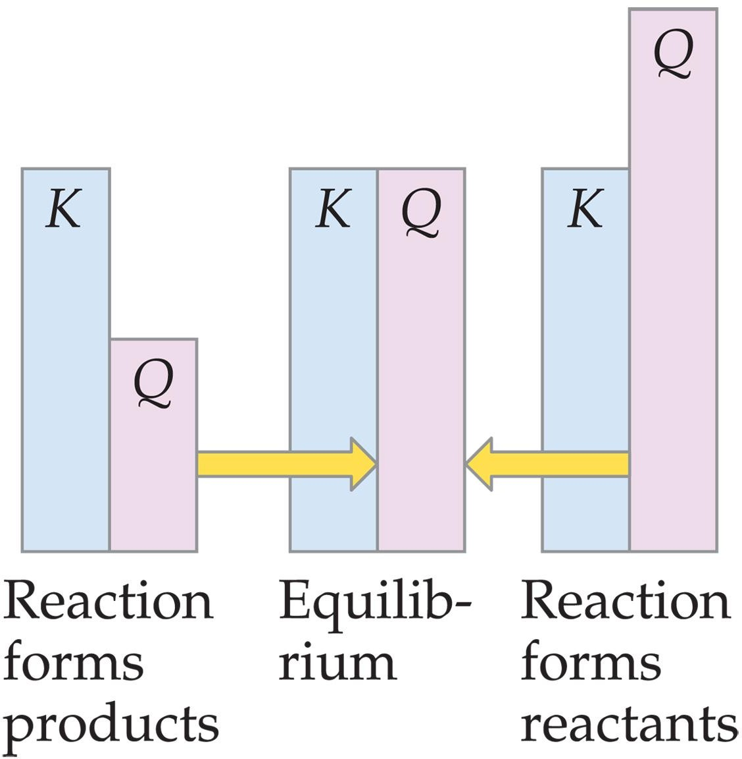
If Q = K,
the system is at equilibrium.

Slide 44
If Q > K,
there is too much product and the
equilibrium shifts to the left.

Slide 45
If Q < K,
there is too much reactant, and the
equilibrium shifts to the right.

Slide 46
Le Châtelier‘s Principle

Slide 47
Le Châtelier‘s Principle
―If a system at equilibrium is disturbed by a change in temperature, pressure, or the concentration of one of the components, the system will shift its equilibrium position so as to counteract the effect of the disturbance.‖
Systems shift from ―Q‖ towards ―K‖.

Slide 48
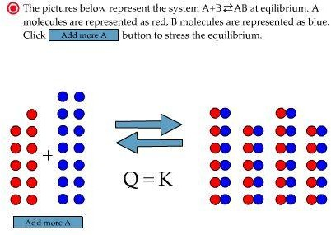
What Happens When More of a Reactant Is Added to a System?

Slide 49
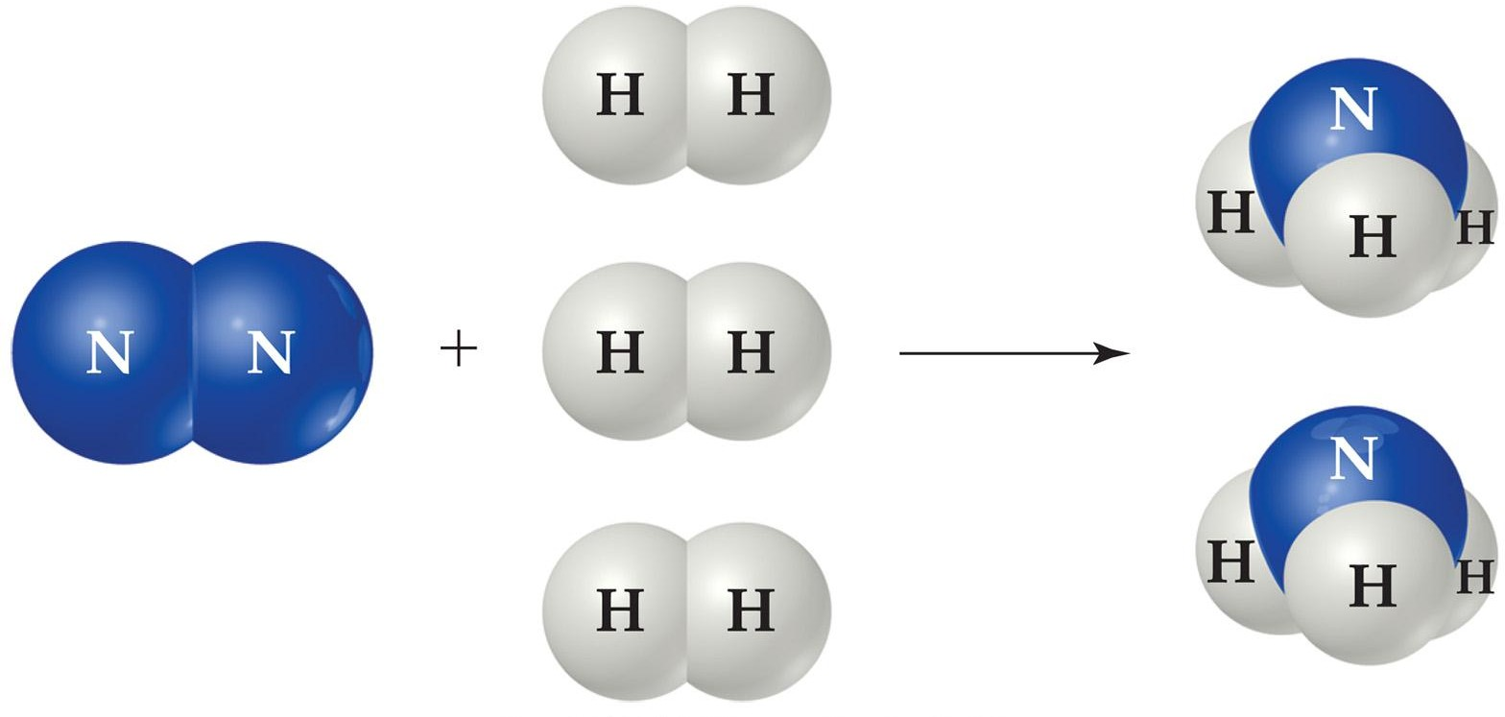
The Haber Process
The transformation of nitrogen and hydrogen into ammonia (NH₃) is of tremendous significance in agriculture, where ammonia-based fertilizers are of utmost importance.

Slide 50
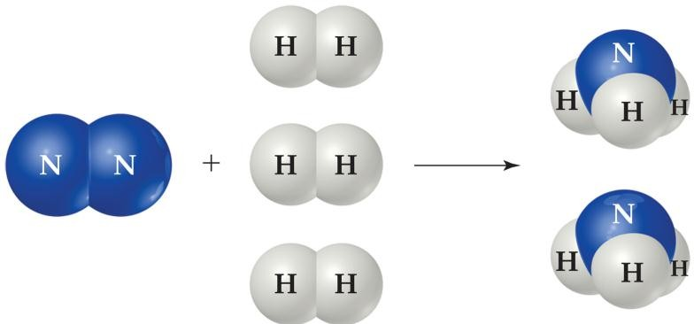
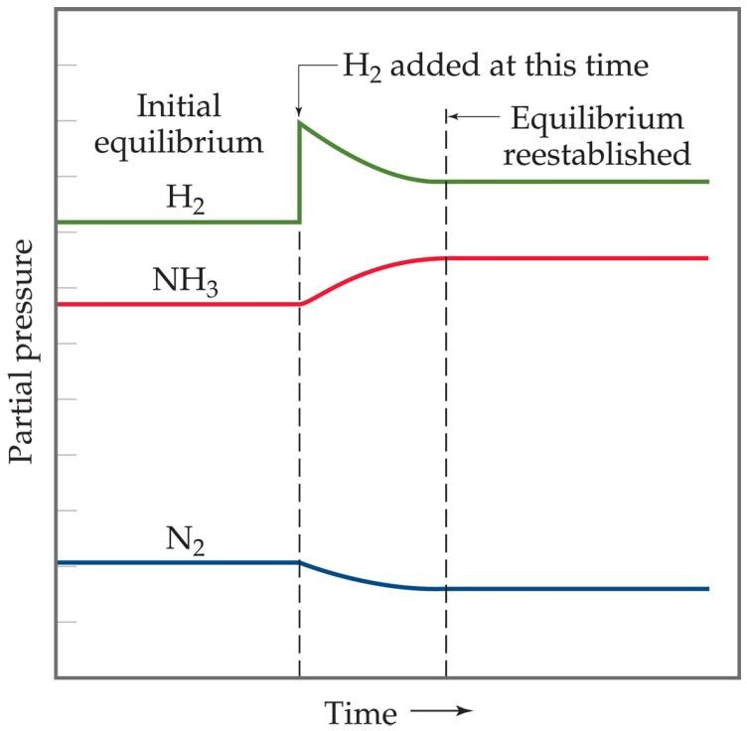
The Haber Process
If H₂ is added to the system, N₂ will be consumed and the two reagents will form more NH₃.

Slide 51
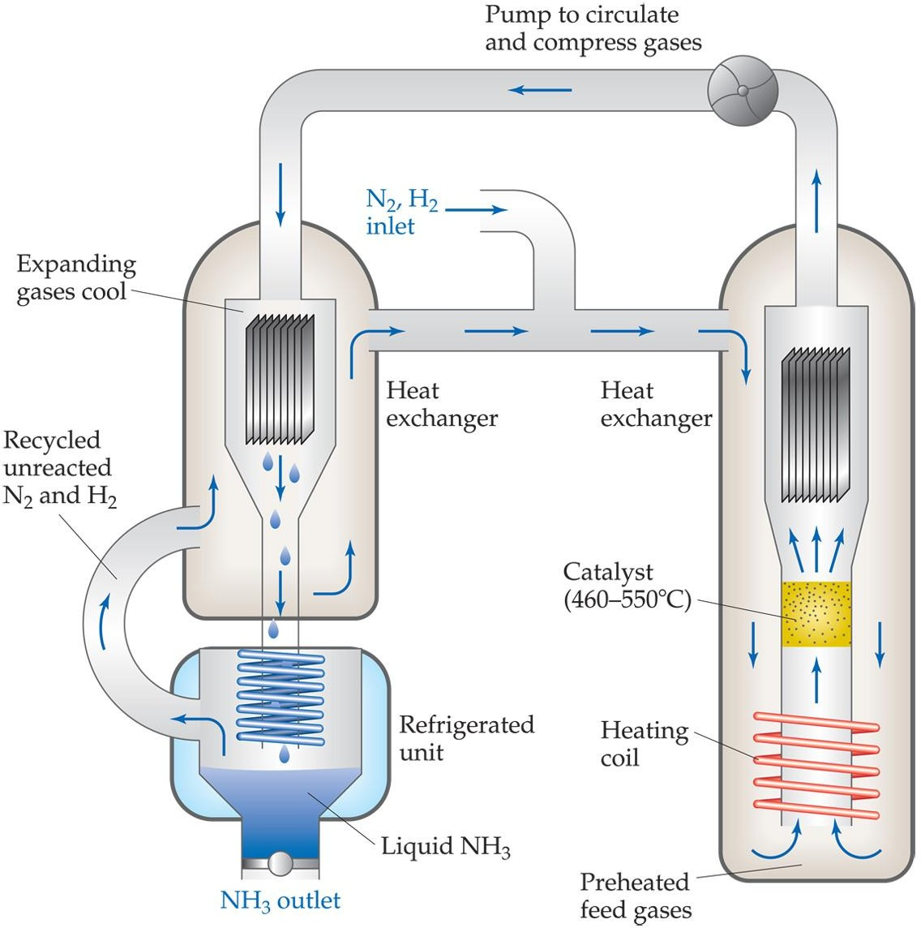
The Haber Process
This apparatus helps push the equilibrium to the right by removing the ammonia (NH₃) from the system as a liquid.

Slide 52
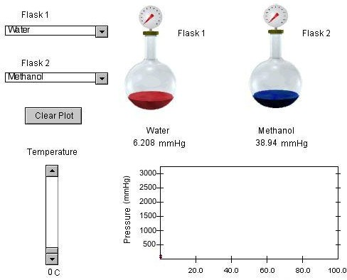
The Effect of Changes in Pressure

Slide 53
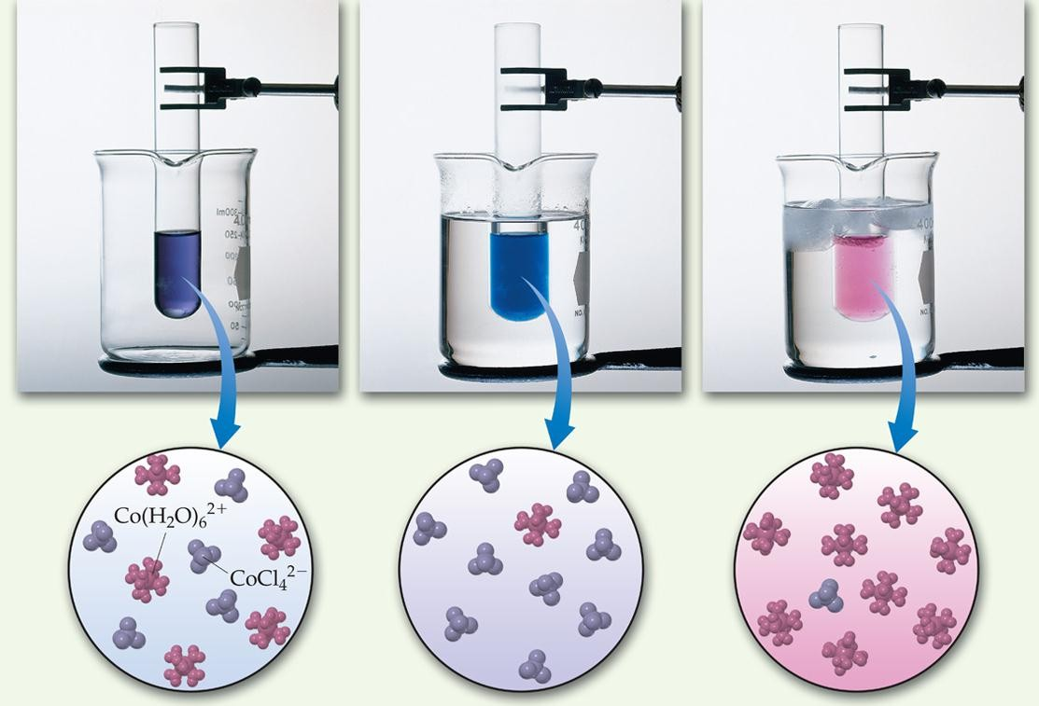
The Effect of Changes in Temperature
Co(H₂O)_{6 (aq)} + 4 Cl_{(aq)}
2+
^{CoCl}4 (aq) ^{+ 6 H}2^{O} (l)

Slide 54
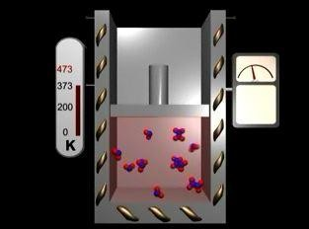
The Effect of Changes in Temperature

Slide 55
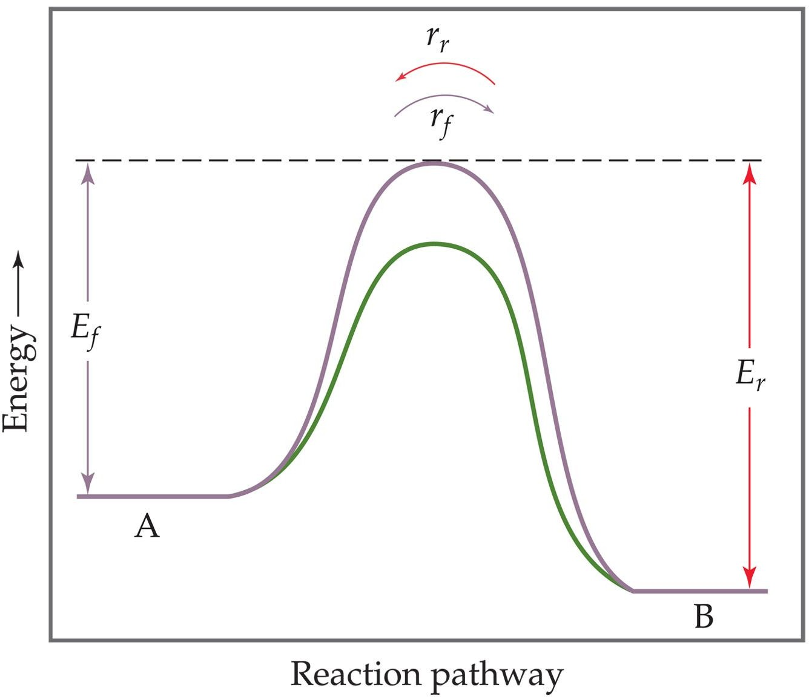
Catalysts increase the rate of both the forward and reverse reactions.

Slide 56
Equilibrium is achieved faster, but the equilibrium composition remains unaltered.

Slide 57
